Slide 1

Source Selection and Purposeful Use
Module 5, Foundations for Collaborative Research

Slide 2

Overall—The Reading/Research Process
Question
Source
Research is recursive:
Have a topic, even broadly
Look up that topic (little ‘r’ research)
See specific examples, keywords, concepts of interest in sources
Start looking up those examples, keywords, concepts of interest, build new understanding
Reform, revise, narrow, refine topic/research question
Repeat 3-5 for continuous revision/refinement
Refined question informs more (little ‘r’) research, becomes directed Big ‘R’ Research

Slide 3
Generally Proper Sources
Digital Databases
Web Sources
Print Sources
Academic, peer reviewed sources; relevant, current (depending on topic); attributable, with full citations and works cited/bibliographic info (search using abstracts)
“Primary sources”--govt. Websites, legal language, contracts, studies, census publications; public libraries, university websites, government websites, etc.
Relevant books; artistic if doing something in literary or artistic interpretation (primary source); deep analyses, anthologies, etc. in expository work (secondary source)

Slide 4

What to Stay Away From
Questionable sources are those with a poor reputation for checking the facts, or with no editorial oversight. Such sources include websites and publications expressing views that are widely acknowledged as extremist, or promotional in nature, or which rely heavily on rumors and personal opinions.
Questionable sources are generally unsuitable for citing contentious claims about third parties, which includes claims against institutions, persons living or dead, as well as more ill-defined entities.
The proper uses of a questionable source are very limited (specifically: research INTO questionable sources/perspectives, in which case they would serve as primary evidence ONLY).
[Per Wikipedia on “reliable sources”]
Can’t find a publication date? Author(s)? Revision date? Publication team or process?
Skip it…

Slide 5
A Note on Self-Published Sources
E-books, newsletters, wikis, blogs, personal websites, social media sites/videos, tweets…
Depends on your plan:
Analyzing these? Cool.
Using as support? Eh

Slide 6
Remember—Quick Evaluation
Evidence has to satisfy the following:
Must be sufficient
Must be precise/accurate
Must be representative (collectively, holistically)
Must be authoritative
Additional thought too; relevance is also key
(also see: the “CRAAP” Test)

Slide 7

What it Means to be “Sufficient”
Careful reading = skeptical reading
Avoid trivial mistakes
Double-check ALL sources, source authors, source publishers—find bias
NOTE: if you use dubious evidence, purposefully, address that it may be problematic; this builds ethos

Slide 8
What it Means to be “Precise”
Avoid “hedging” claims
Avoid superlatives, or empty comparisons
Margin of error depends on the field
Word choice is super important

Slide 9
What it Means to be “Representative”
General error is too little evidence
Think about the full range of variation/availability
Small sample sizes are generally problematic (must be acknowledged explicitly)
Avoid “cherry-picking” and the anecdotal

Slide 10
What it Means to be “Authoritative”
See what other researchers are valuing or devaluing (this means a breadth of research, and pay attention to their citations and the neg/pos of those works)
Pay attention to ‘failed arguments’ (what NOT to do)
Think about ‘degrees of authority’ on an issue

Slide 11
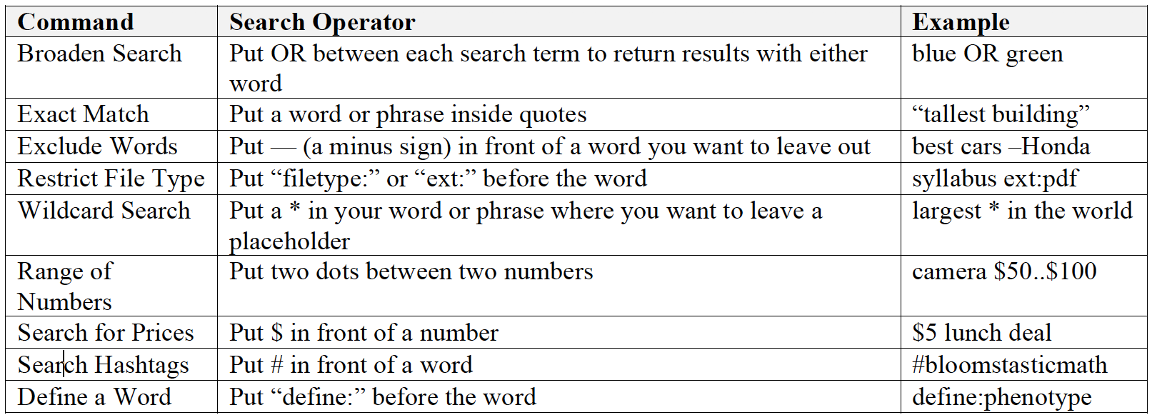
Boolean: Ways to Engage, Expand, or Narrow in the Process

Slide 12

Sorting Sources by Function (in Relation to Research Question)
Primary
Original sources of information that are the basis of the research topic in question–includes information that is yet to be analyzed, pure facts and/or statistics, original works, and the original stories or perspectives under investigations.
Secondary
Publications that provide analysis to the original information that is the basis of primary sources (includes interpretations, judgments, reviews, synthesis of perspectives, etc.)

Slide 13
Review - Available Lenses
Cultural/Social Explores how daily issues have impact on lives, relationships, customs, beliefs, etc. | Artistic/Philosophical Explores how art works express ideas about an issue, and/or what philosophers think at a meta-level | Ethical Explores issue at moral level, considers things such as laws, human rights, consequences of actions, effects, etc.
Political/Historical Explores effect of issue on government decisions, considers contextual background or causal relationship of events in relation to issue | Environmental/Scientific Explores contextual effects of an issue on social, ecological environment; uses data from biological, chemical, physical level | Economic Explores financial impact of issue and role in possible solutions on both personal, communal level

Slide 14
Purposeful Use – Social/Cultural Research
Some Potential Primary/Secondary Types
Primary
Observations of people (anthropological research), interviews of people about social/cultural issues, first-hand accounts and personal stories, biographies, diaries and/or letters, survey data, media/social media posts/publications
Secondary
Arguments of perspectives analyzing the above data types, reviews of perspectives, articles defending social agendas or political positions on social/cultural issues, comparisons

Slide 15
Purposeful Use – Artistic/Philosophical Research
Some Potential Primary/Secondary Types
Primary
Art works (painting, short stories, poems, sculpture, etc.), biographies, manifestos, philosophical essays, etc.--by the artists/philosophers themselves
Secondary
Analytic and/or interpretive essays, secondary research papers, comparison papers, reviews, works made or written by artists/philosophers responding to the original work

Slide 16
Purposeful Use – Ethical Research
Some Potential Primary/Secondary Types
Primary
Written meta-ethical systems by philosophers, political acts (the actual legal language from passed legislation), position papers written by politicians, legal decisions from court cases, surveys or interviews or letters/diaries/case studies from individuals regarding ethical decisions, media/social media posts/publications
Secondary
Reviews, essays, commentary on any of the primary sources, responses to legal decisions or legislation, research paper discussion sections, competing views and perspectives analyzing primary sources

Slide 17
Purposeful Use – Political/Historical Research
Some Potential Primary/Secondary Types
Primary
Diaries/letters from historical individuals, legal documents, legislative decisions, timelines and artifacts, artworks and/or writings of specific individuals or groups, published perspectives from the individual/groups in focus, media/social media posts/publications
Secondary
Analysis of perspectives, writings, artworks, legal language, political documents; comparisons, analysis of similar issues from which to compare or methods to apply, opposing understandings of historical events/timelines

Slide 18
Purposeful Use – Environmental/Scientific Research
Some Potential Primary/Secondary Types
Primary
Results from experiments, field notes, observations of scientific phenomena, reports, original data in tables and charts (pure, unanalyzed information)
Secondary
Analysis of experiments, reviews of published data, articles providing judgments, conference presentations, research papers’ discussions and results pages

Slide 19
Purposeful Use – Economic Research
Some Potential Primary/Secondary Types
Primary
Government documents and legal language, monetary figures and tables/charts; to be compared with other political/historical primary data (see other slides)
Secondary
Reviews of monetary trends and currency transactions, analysis or comparisons of legal language or other primary data sets, macroeconomic manifestos or perspectives to compare or apply to primary data sets, analytic perspectives

